Slide 1
SESSION 4
Unsupervised Learning
for Discovery
Goal
Core idea
discover structure in unlabeled data while avoiding over-interpretation.
Clusters are mathematical groupings. They become meaningful only after domain interpretation and validation.
Clustering • PCA • DBSCAN • Interpretation • Validation • Limitations
Session outputs
• Unsupervised problem statement
• Scaled feature table
• Cluster interpretation plan
• Validation approach
• Limitation statement
Applied AI Design Workshop for Faculty
Fred Livingston (fjliving@ncsu.edu) 2026

Slide 2
APPLIED AI DESIGN WORKSHOP
Session 4
Session 4 learning outcomes
Distinguish
Cluster
Prepare
Validate
Interpret
Explain supervised vs. unsupervised learning and when labels are absent
Describe k-means, hierarchical clustering concepts, and DBSCAN at a level
Scale variables and choose features before clustering
Use metrics, visual inspection, and domain checks to assess structure
Translate clusters into hypotheses without claiming causality or truth
Participant output: a clustering plan that includes features, scaling, validation, interpretation, and limitations.

Slide 3
APPLIED AI DESIGN WORKSHOP
Session 4
Activity roadmap
Frame
Prepare
Cluster
Visualize
Validate
Interpret
What structure are we looking for?
Scale and select features
k-means, hierarchy, DBSCAN
PCA and cluster plots
Metrics and stability checks
Domain meaning and limits
Note
The point is not to “find the right clusters.” The point is to generate defensible hypotheses about structure in unlabeled data.
Unsupervised learning supports discovery, exploration, segmentation, and data-quality investigation.

Slide 4
APPLIED AI DESIGN WORKSHOP
Session 4
What makes a problem unsupervised?
Unsupervised learning searches for structure without a known target label.
Supervised learning
Unsupervised learning
Common use
Known target label:
• strength value
• defect / no defect
• pass / fail
• diagnosis
Question: can inputs predict the target?
No target label:
• unknown groups
• operating regimes
• abnormal cases
• latent patterns
Question: what structure exists?
Explore data before labels exist, identify natural groupings, or create hypotheses for follow-up experiments.
Unsupervised results are usually starting points for investigation, not final decisions.

Slide 5
APPLIED AI DESIGN WORKSHOP
Session 4
Applied examples of unsupervised discovery
Domain
Data
Discovery question
Manufacturing
temperature, speed, vibration, energy
Are there distinct operating regimes?
Bioprocessing
pH, dissolved oxygen, agitation, OD trajectory features
Which batches behave similarly?
Education
assignment timing, submissions, interaction frequency
Are there patterns of student engagement?
Materials
composition, process settings, measured properties
Do material families emerge from the data?
Maintenance
sensor summaries from equipment cycles
Which cycles look atypical or degraded?
A good unsupervised question connects data patterns to a plausible disciplinary interpretation.

Slide 6
APPLIED AI DESIGN WORKSHOP
Session 4
Part 1: prepare the feature table
Clustering is sensitive to feature choice and scale.
Choose features
Scale numeric data
Handle missing data
Use variables that represent the phenomenon of interest. Remove identifiers and target-like columns.
Variables with large units can dominate distance-based methods. Standardize before k-means, PCA, and many distance methods.
Impute carefully or remove variables with too much missingness. Missingness may itself carry meaning.
Guiding question
Do the selected features describe similarity in the way a domain expert would understand it?

Slide 7
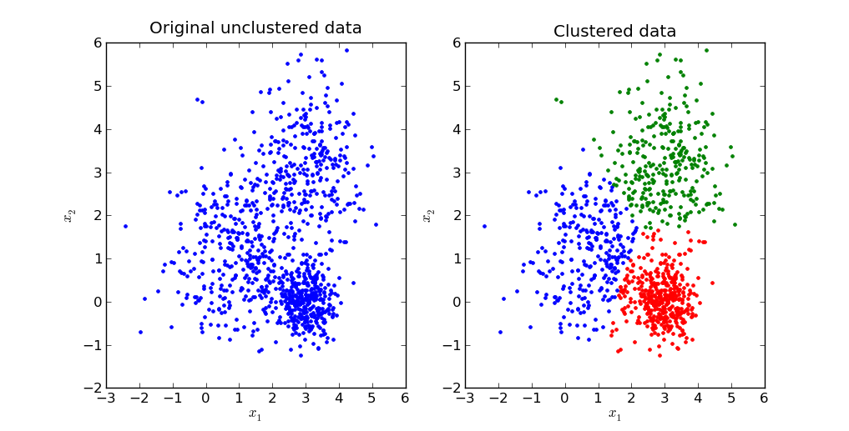
APPLIED AI DESIGN WORKSHOP
Session 4
k-means clustering: compact groups around centers
k-means partitions observations into K groups by minimizing distance to cluster centers.
Requires K
Works best when
You must choose the number of clusters before fitting.
Clusters are compact, separated, and roughly similar in size.
Sensitive to scale
Interpretation risk
Standardization strongly affects distance calculations.
A cluster number does not automatically equal a real category.
Source: https://brilliant.org/wiki/k-means-clustering/
Use k-means when a compact-center view of similarity is defensible.

Slide 8
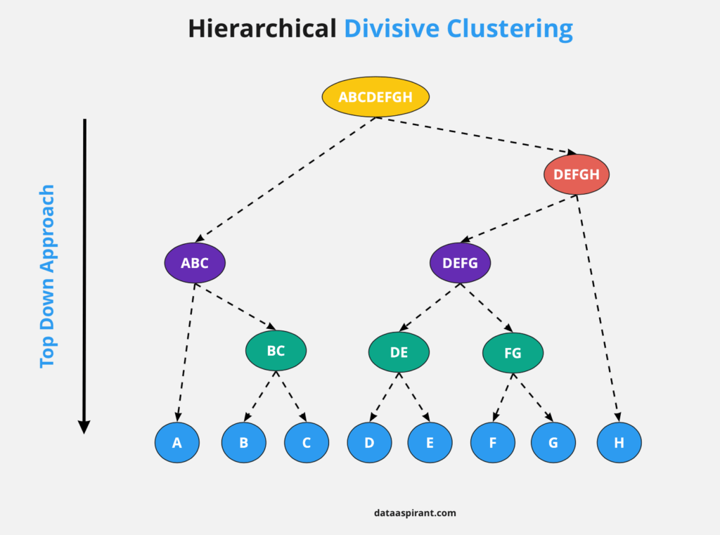
APPLIED AI DESIGN WORKSHOP
Session 4
Hierarchical clustering: nested similarity structure
Hierarchical methods show how observations merge into groups at different levels of similarity.
Strength
Choice point
Reveals nested structure and does not require choosing K before fitting.
Cut the tree at a level that balances detail and interpretability.
Key inputs
Caution
Distance metric and linkage method influence results.
Can be hard to read for very large datasets without sampling or summarization.
Source: https://dataaspirant.com/hierarchical-clustering-algorithm/
Hierarchical clustering is useful when you want to see structure at multiple resolutions.

Slide 9
APPLIED AI DESIGN WORKSHOP
Session 4
DBSCAN: dense groups and noise points
DBSCAN groups observations in dense regions and can label sparse points as noise.
Strength
Parameters
Finds irregularly shaped clusters and identifies noise or outliers.
eps controls neighborhood size; min_samples controls density requirement.
Works best when
Caution
Clusters differ from noise by density and the scale of distance is meaningful.
Can struggle when clusters have very different densities.
DBSCAN is useful when “unusual” observations matter as much as group membership.

Slide 10
APPLIED AI DESIGN WORKSHOP
Session 4
PCA for visualization and simplification
Principal component analysis projects high-dimensional data into fewer dimensions.
What PCA does
Why use it here?
Important caution
Finds directions of maximum variation and creates new component axes.
Visualize clusters, detect redundancy, and summarize many correlated features.
PCA components are combinations of variables, not original physical quantities.
Component
Interpretation question
PC1
Which variables load strongly and define the main direction of variation?
PC2
What additional variation is captured beyond PC1?
Explained variance
How much of the original variation is retained?
PCA is a lens for exploration, not a guarantee of meaningful clusters.

Slide 11
APPLIED AI DESIGN WORKSHOP
Session 4
How do we validate unsupervised results?
There is no single accuracy score because there is no target label.
Internal metrics
Stability checks
Domain validation
Silhouette score, within-cluster distance, cluster separation. Useful but not enough.
Do clusters persist under new samples, resampling, or small feature changes?
Do clusters align with known mechanisms, regimes, or follow-up measurements?
Key principle
A useful cluster should lead to a testable explanation or practical action.
Validation combines math, visualization, and domain evidence.

Slide 12
APPLIED AI DESIGN WORKSHOP
Session 4
Interpreting clusters: from groups to hypotheses
Cluster labels such as 0, 1, and 2 are not explanations by themselves.
Step
Question to ask
Describe each cluster
What are the average feature values and ranges?
Compare to metadata
Do clusters differ by machine, batch, cohort, material, or time period?
Inspect examples
What do representative and borderline cases look like?
Name carefully
Use descriptive names only after evidence supports them.
Plan follow-up
What experiment, label review, or expert check would validate the hypothesis?
A cluster is a hypothesis generator; domain experts decide whether the pattern is meaningful.

Slide 13
APPLIED AI DESIGN WORKSHOP
Session 4
Session 4 technical skill: minimal clustering workflow
Goal: scale features, run k-means, visualize clusters, and compute an internal metric.
import pandas as pd
from sklearn.preprocessing import StandardScaler
from sklearn.cluster import KMeans
from sklearn.decomposition import PCA
from sklearn.metrics import silhouette_score
features = ["temperature", "pressure", "vibration", "energy"]
X = df[features]
X_scaled = StandardScaler().fit_transform(X)
model = KMeans(n_clusters=3, random_state=42, n_init=10)
clusters = model.fit_predict(X_scaled)
df["cluster"] = clusters
print("Silhouette:", silhouette_score(X_scaled, clusters))
pca = PCA(n_components=2)
coords = pca.fit_transform(X_scaled)
Notebook
Use the Session 4 unsupervised learning notebook or embedded technical notebook.
“What evidence would convince you these clusters are meaningful?”
Coding focus
Scale → cluster → visualize → interpret → validate.

Slide 14
APPLIED AI DESIGN WORKSHOP
Session 4
Discussion prompts
• What does it mean for two observations to be similar?
• Which variables should define similarity — and which should not?
• How many clusters would be useful rather than merely mathematical?
• Do the clusters persist if features or scaling change?
• Are clusters aligned with meaningful metadata or known regimes?
• What follow-up evidence would validate the interpretation?
• What should not be concluded from the clusters?
Synthesis
Unsupervised learning helps faculty explore structure, generate hypotheses, and guide data collection — but it does not replace labels, experiments, or domain judgment.
The most important output is not a cluster label — it is a defensible interpretation plan.

Slide 15
APPLIED AI DESIGN WORKSHOP
Session 4
Session 4 wrap-up: what you should take forward
Before clustering
During clustering
After clustering
• Define the discovery question
• Choose the unit of observation
• Select meaningful features
• Remove IDs and leakage variables
• Scale numeric data
• Compare simple methods
• Visualize with PCA
• Check sensitivity to K and features
• Inspect representative cases
• Record assumptions
• Describe cluster profiles
• Validate with metadata or experts
• Avoid causal claims
• Plan follow-up labeling
• State limitations clearly
Day 4 endpoint: You can complete a baseline supervised workflow and design an unsupervised discovery analysis.

